Slide 1
GROCERY MART SYSTEM
TEAM MEMBERS-
VANDITA SINGH GAUTAM(1900970100125)
SHIV CHANDRA YADAV(1900970100109)
TANISHK MEROTHIYA(1900970100120)
VIKAS kUMAR BEDI (1900970100127)

Slide 2
INTRODUCTION
The Grocery Management System is developed to facilitate the work of the grocery storekeeper and the customer who buys the products. This system consists of the methods which can relate the perpetual crisis while managing the rhetoric quandaries concerning the authoritarian source.
The Grocery Shopping System keeps track of all information about a product, including its manufacturer, type, customer, and stock. This system can also maintain track of the personal information of customers. The grocery shopping system is a PHP and SQL-based online application. It allows you to manage your grocery store, customer information, and assist in the online sale of your groceries

Slide 3
OBJECTIVE
This project's main purpose is to maintain track of all the information about the different stores, their selling products, customer information, and order information. This system also aids in the management of grocery inventory, restocking, sales, refunds, purchases, and other tasks. It increases the number of employment available and the number of opportunities to participate in earning activities.

Slide 4
SYSTEM REQUIREMENTS

Slide 5
HARDWARE REQUIREMENTS

Slide 6
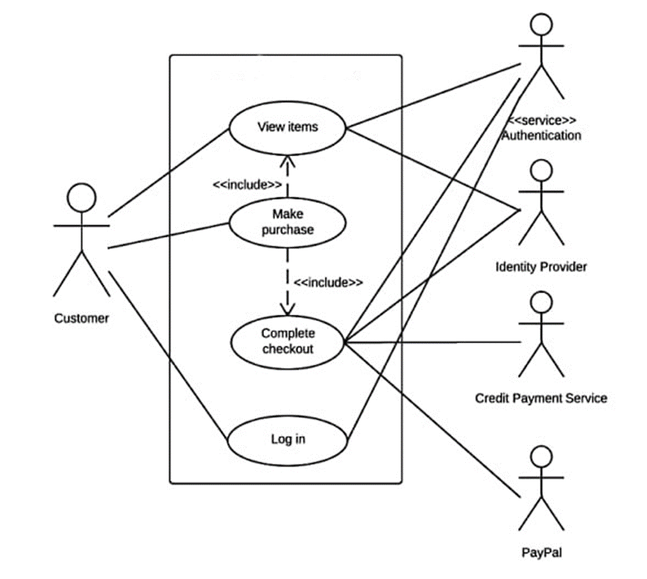
USE CASE DIAGRAM

Slide 7
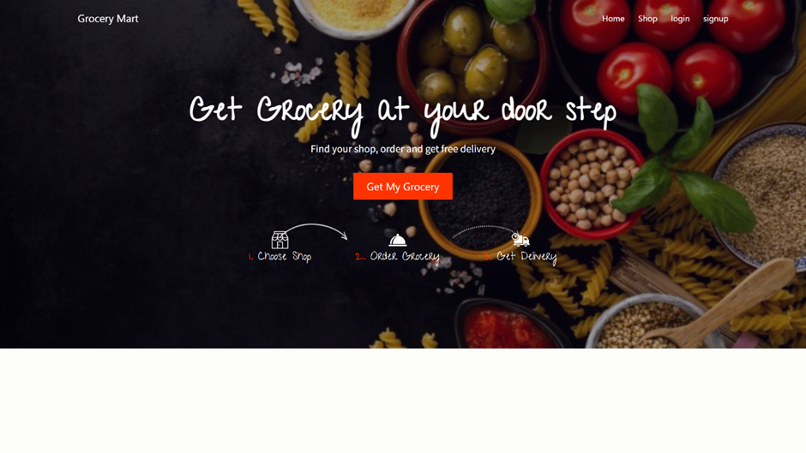
SCREEN LAYOUT

Slide 8
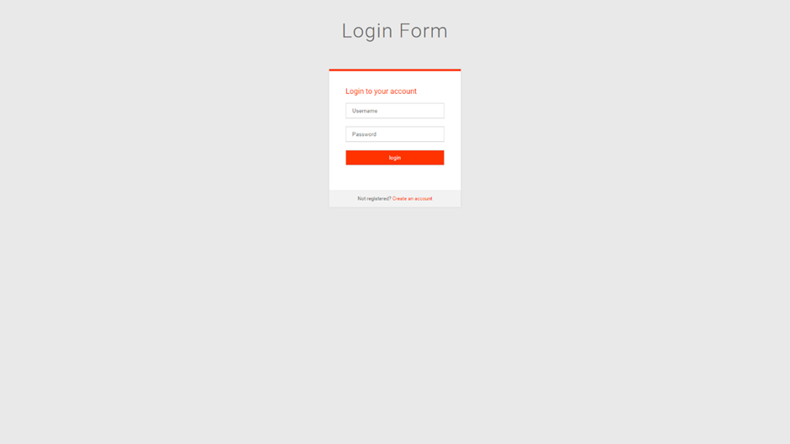
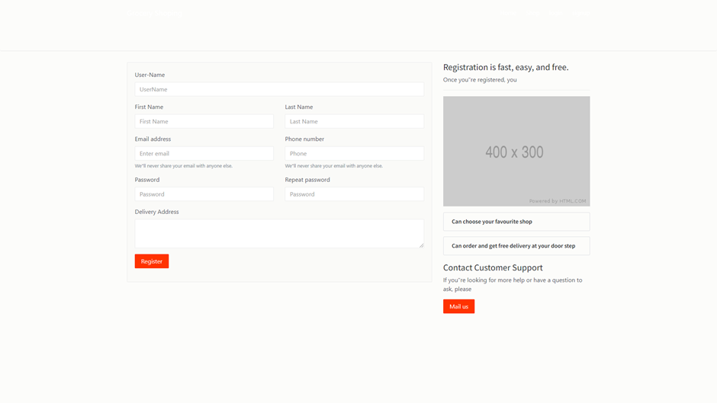
LOGIN PANEL

Slide 9
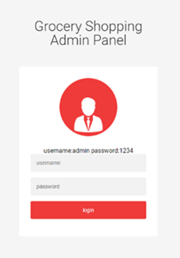
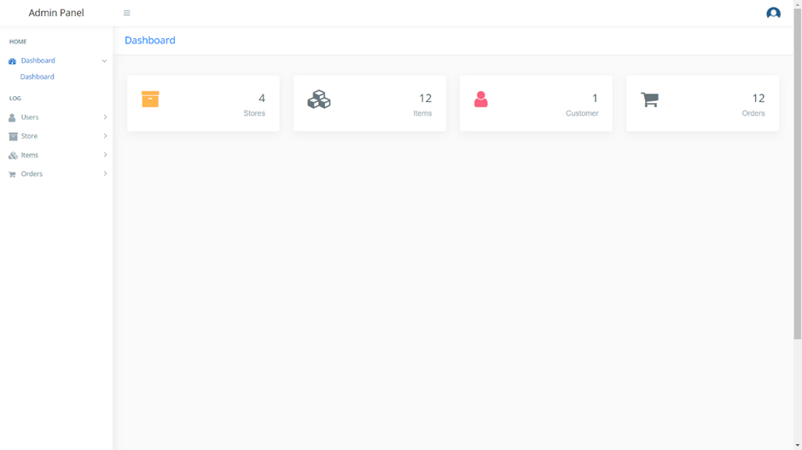
ADMIN PANEL

Slide 10
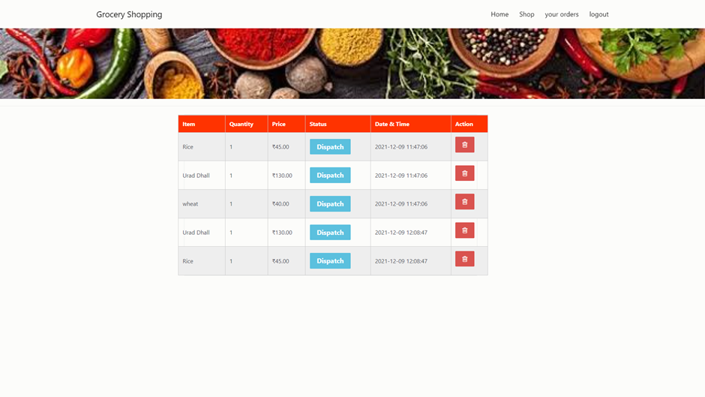
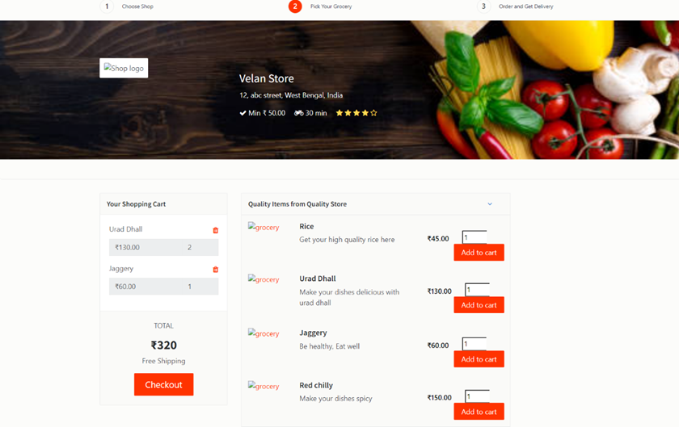
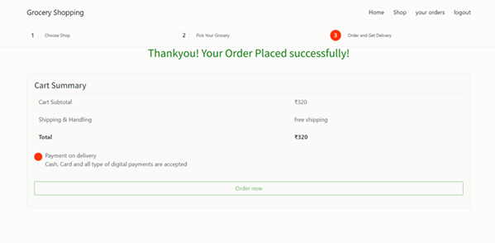

Slide 11
MODULE DESCRIPTION
Admin Panel
Admin has the official powers to control the flow of the data from one part of the system to the other. He can manipulate the access of the users to the data. The primary purpose of this account is to make the user data relevant and then giving the inputs to the other interface module and make it work optimistically and get the timetable according to the wish we want to create for a particular type of inputs.
Hence all the data will be reflected in clean and well data in the interfaces.
(i) Dashboard
(ii) User Management
• Add User
• Update / Delete User
(iii) Store Management
• Add Store
• Update / Delete Store

Slide 12
MODULE DESCRIPTION
(iv) Item Management
• Add Item to specific Store
• Update/ Delete Item
(v) Order Management
• Order Management
• Get all Order Details
• Take Action on Order
• Dispatch – For new order
• On the way – If the order ready for packing
• Cancelled – If the ordered item is unavailable

Slide 13
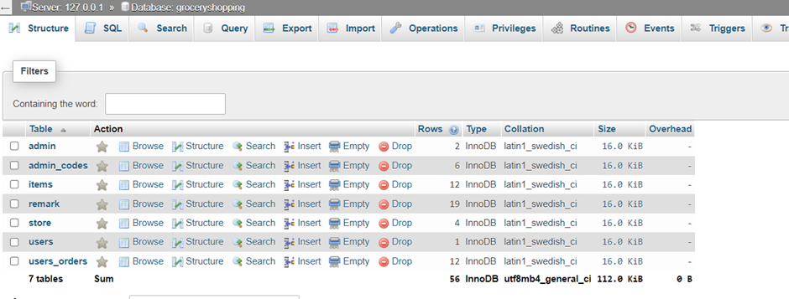
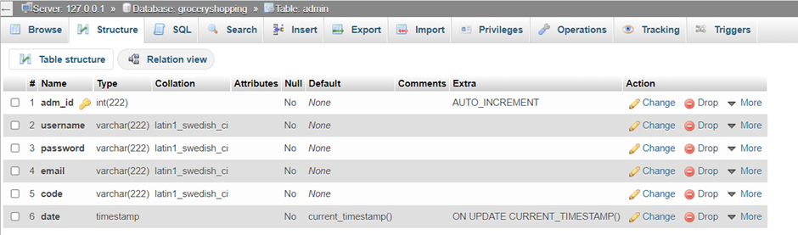
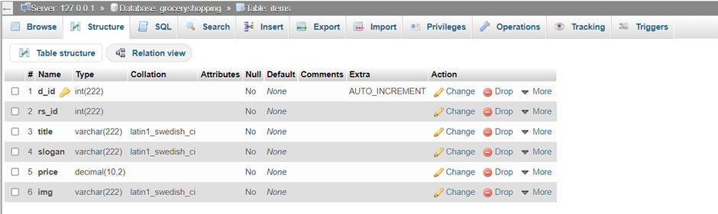
DATABASE TABLES

Slide 14
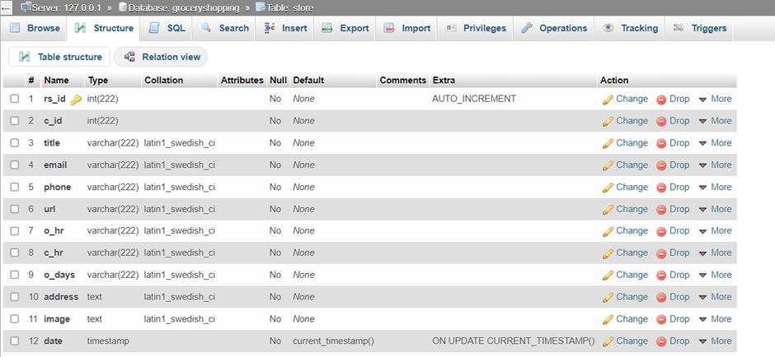
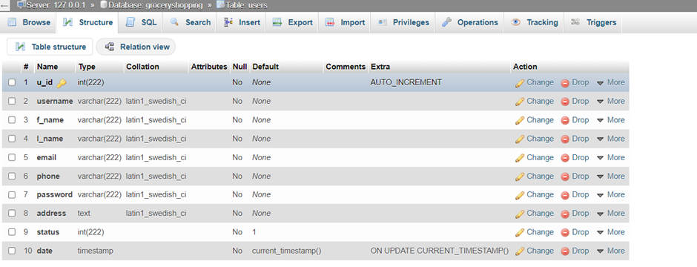
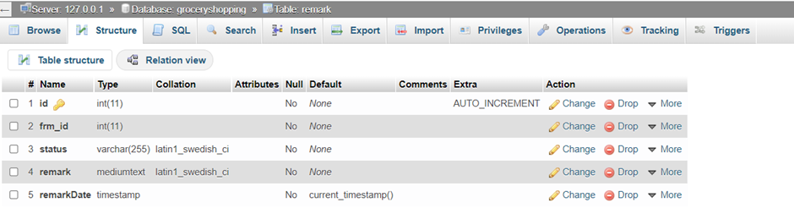
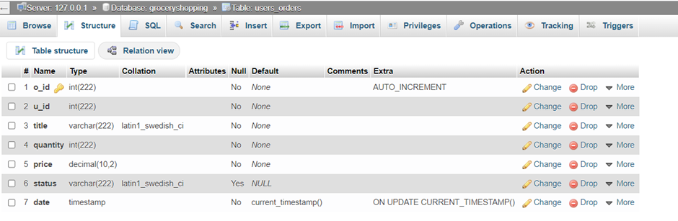
DATABASE TABLES

